Slide 1
XG Boosting

Slide 2

XG Boost

Slide 3
What is XG Boost
Bad remainders are combined to cancel out bad
Regularization
Gamma- minimum reduction of loss, create many leaf weights
lamda- leaf weights decreases

Slide 4
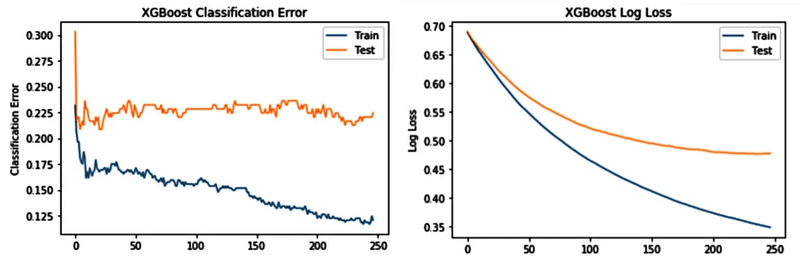

Slide 5
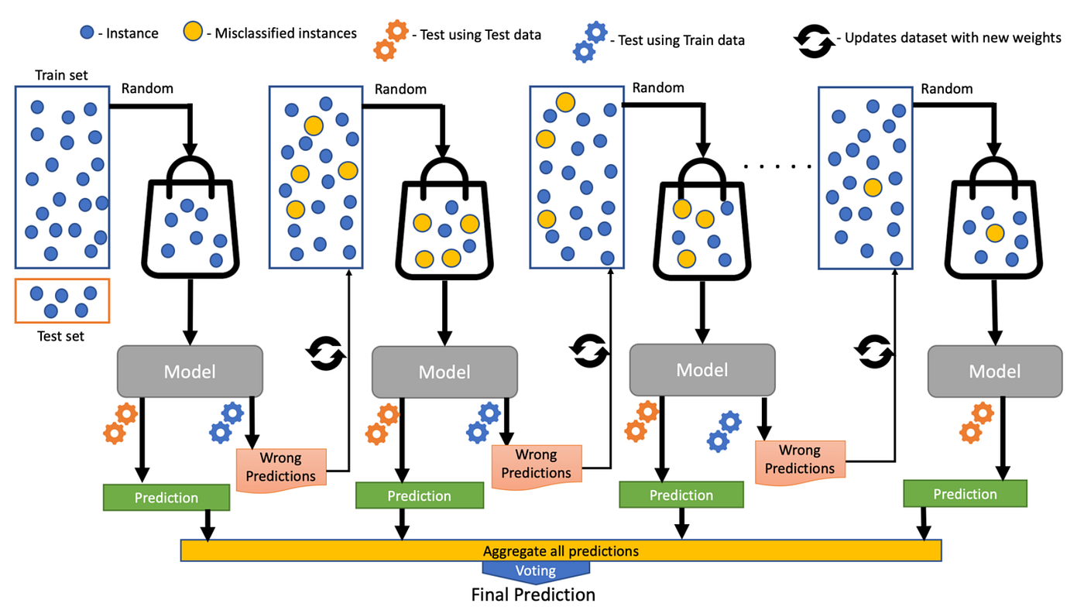
How it works

Slide 6
Advantages & Disadvantages
Adv:
Effective with large datasets
Work on non linear data
More practice but good accuracy
DisAdv:
Overfit if the trees are over deep

